Slide 1
Predictive Modeling
Chapter 1: Introduction to Predictive Modeling
STA 6543
The University of Texas at San Antonio

Slide 2
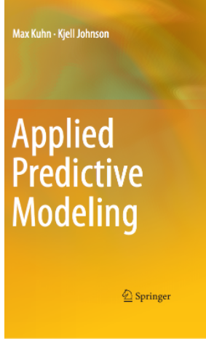
Textbook information
Applied Predictive Modeling http://appliedpredictivemodeling.com/
The AppliedPredictiveModeling R package contains many of the data sets used here and R scripts to reproduce the analyses in each chapter of the book.

Slide 3
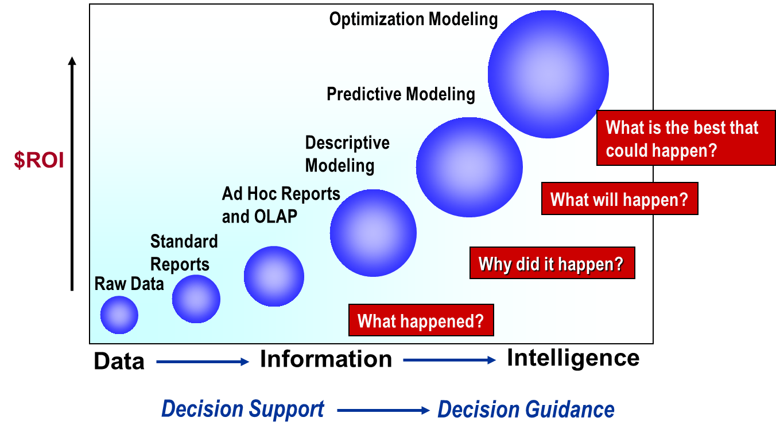
Overview of statistical data analytics

Slide 4
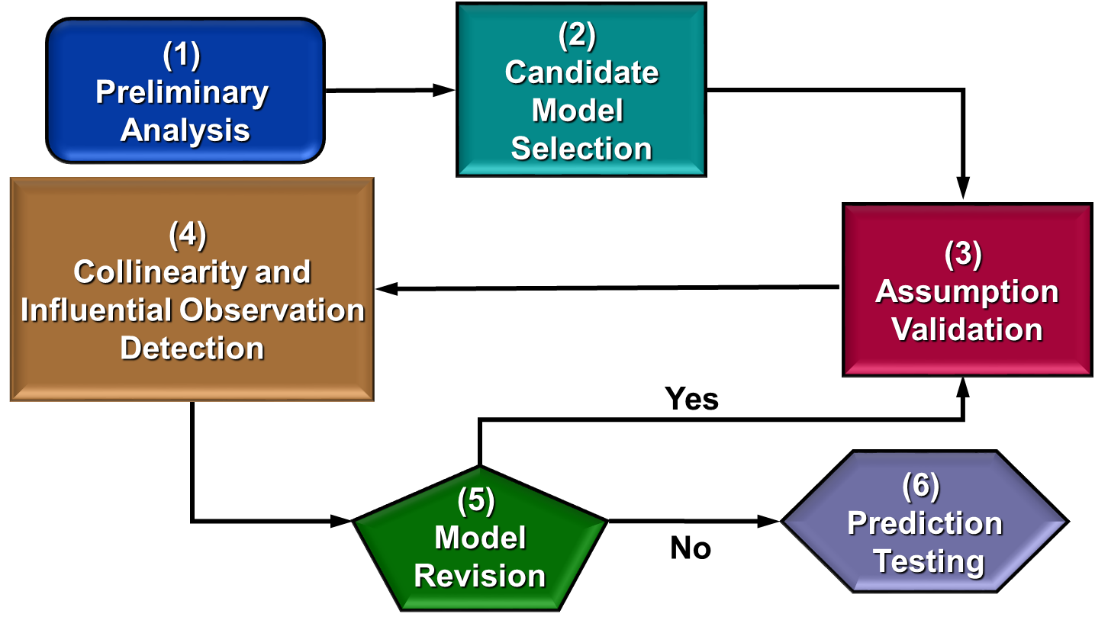
Overview of statistical data analytics

Slide 5
What is predictive modeling?
What Is predictive modeling?
Definition of predictive modeling
The trade-off between prediction accuracy and model interpretability
Supervised vs. unsupervised learning
Regression vs. classification problems
Introduction to R (Lab 1)

Slide 6
What is predictive modeling?
Chapter 1

Slide 7
What is predictive modeling?
Predictive modeling: the process of developing a mathematical tool or model that generates an accurate prediction.

Slide 8
Examples
How many copies will this book sell?
How much will my house sell for in the current market?
Will this customer move their business to a different company?
Does a patient have a specific disease?
Should I sell this stock?
Is an e-mail spam?
Will this patient respond to this therapy?

Slide 9
Some tradeoffs
Prediction accuracy versus interpretability.
Linear models are easy to interpret; non-parametric models are not.
Good fit versus over-fit or under-fit.
How do we know when the fit is just right?
Parsimony versus black-box.
We often prefer a simpler model involving fewer variables over a black-box predictor involving them all.

Slide 10
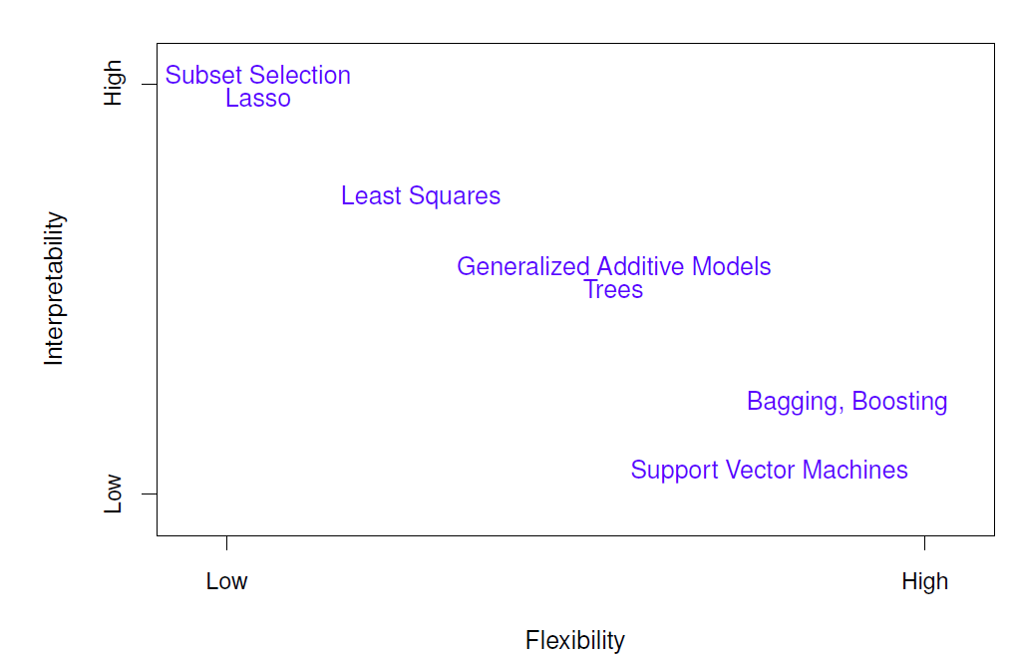
Tradeoff between flexibility and interpretability

Slide 11
Terminology
The term sample often refers to a subset of data points, such as the training set sample.
The training set consists of the data used to develop models while the test or validation sets are used solely for evaluating the performance of a final set of candidate models.
The predictors (X), independent variables, attributes, or descriptors are the data used as input for the prediction equation.
Outcome, dependent variable, target, class, or response (Y) refer to the outcome event or quantity that is being predicted.

Slide 12
Terminology
Continuous data have natural, numeric scales.
Categorical data, otherwise known as nominal, attribute, or discrete data, take on specific values that have no scale
Model building, model training, and parameter estimation all refer to the process of using data to determine values of model equations.

Slide 13

1. Prediction
Consider
If we can produce a good estimate for f (and the variance of ε is not too large) we can make accurate predictions for the response, Y, based on a new value of X.

Slide 14
Example: direct mailing prediction
Interested in predicting how much money an individual will donate based on observations from 90,000 people on which we have recorded over 400 different characteristics.
Don’t care too much about each individual characteristic.
Just want to know: For a given individual should I send out a mailing?

Slide 15
2. Inference
Alternatively, we may also be interested in the type of relationship between Y and the X's.
For example,
Which particular predictors actually affect the response?
Is the relationship positive or negative?
Is the relationship a simple linear one or is it more complicated etc.?

Slide 16
Example: housing inference
Wish to predict median house price based on 14 variables.
Probably want to understand which factors have the biggest effect on the response and how big the effect is.
For example how much impact does a river view have on the house value etc.

Slide 17
The objectives of this course
Foundational principles for building predictive models
Intuitive explanations of many commonly used predictive modeling methods for both classification and regression problems
Principles and steps for validating a predictive model
Computer code to perform the necessary foundational work to build and validate predictive models

Slide 18
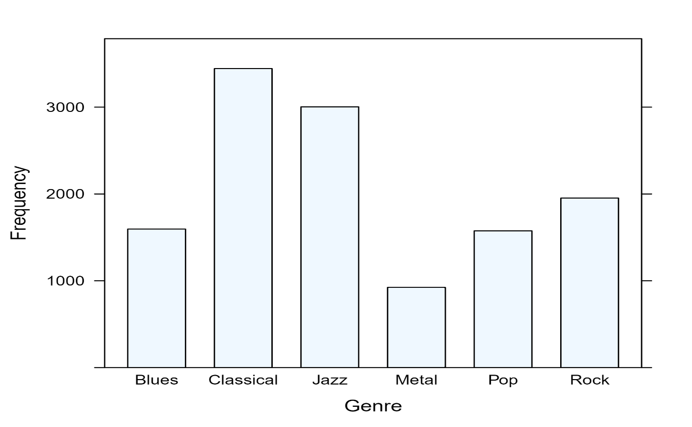
Example: music genre
The objective was to use the predictors to classify music samples into the appropriate music genre.

Slide 19
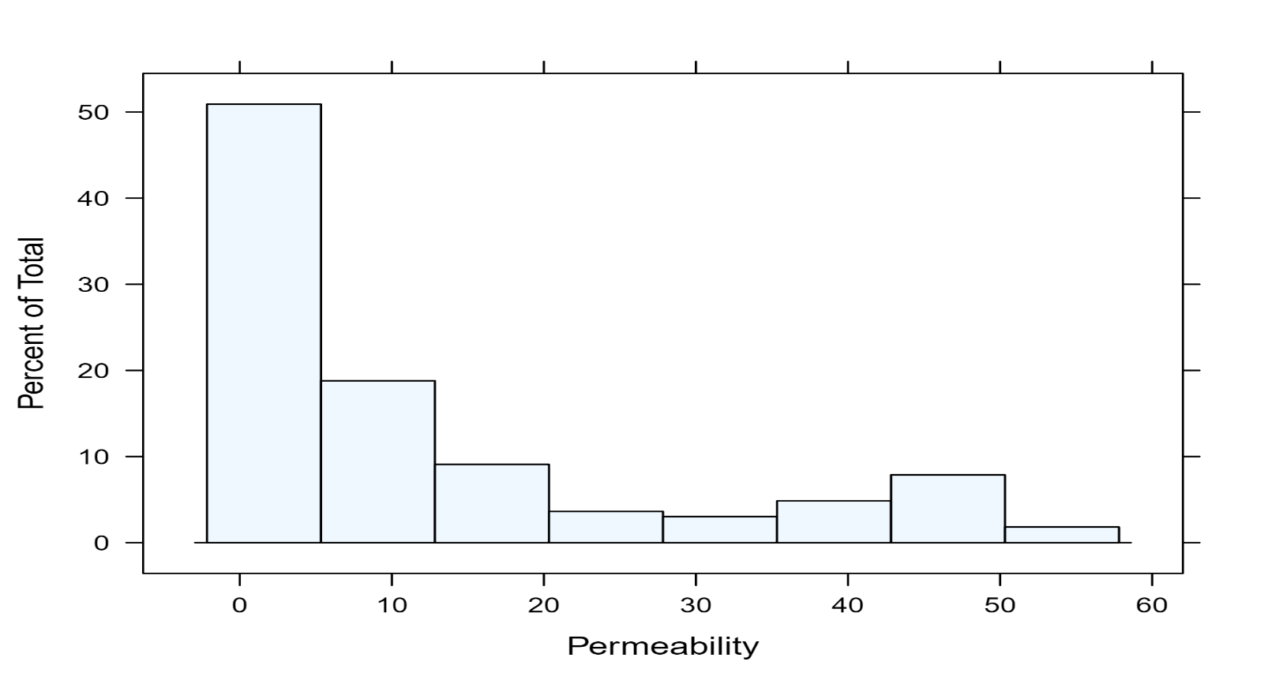
Example: permeability
The objective was to use the predictors to model compounds’ permeability

Slide 20
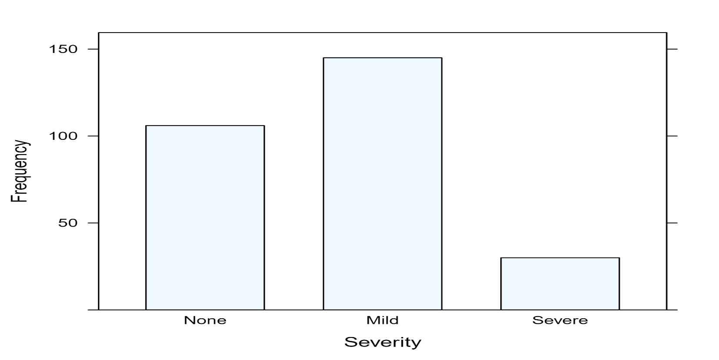
Example: hepatic injury
The objective was to build a predictive model for hepatic injury so that other compounds can be screened for the likelihood of causing hepatic injury.

Slide 21
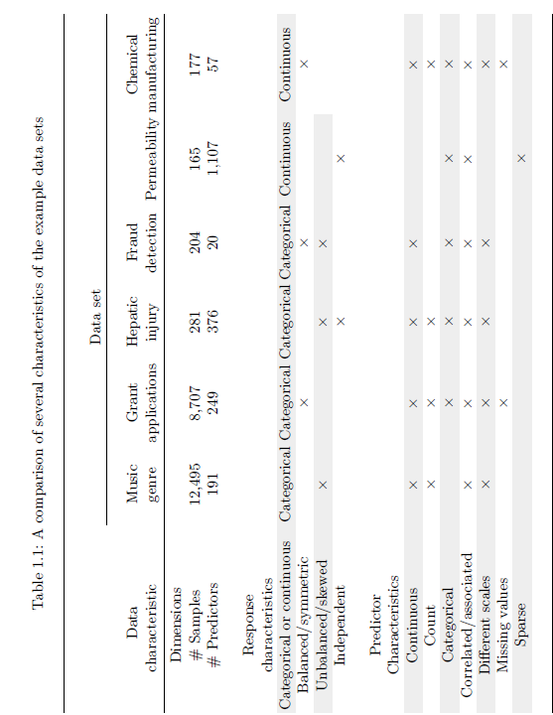

Slide 22
Supervised vs. unsupervised learning
We can divide all learning problems into Supervised and Unsupervised situations
Supervised learning:
Supervised Learning is where both the predictors X and the response Y are observed.
We wish to accurately predict unseen test cases, understand which inputs affect the outcome and how, and assess the quality of our prediction and inferences.
Most of this course deal with supervised learning.
Unsupervised learning:
Only the predictors X are observed.
Use the predictors to groups of samples that behave similarly.
Difficult to know how well you are doing, but can be useful as a pre-processing step for supervised learning.

Slide 23
Regression vs. classification
Supervised learning problems can be further divided into regression and classification problems.
Regression covers situations where Y is continuous/numerical. e.g.
Predicting the value of the Dow in 6 months.
Predicting the value of a given house based on various inputs.
Classification covers situations where Y is categorical e.g.
Will the Dow be up (U) or down (D) in 6 months?
Is this email a SPAM or not?

Slide 24
Philosophy
It is important to understand the ideas behind the various techniques, in order to know how and when to use them.
One has to understand the simpler methods first, in order to grasp the more sophisticated ones.
It is important to accurately assess the performance of a method, to know how well or how badly it is working [simpler methods often perform as well as fancier ones!]
This is an exciting research area, having important applications in science, industry and finance.
Statistical learning is a fundamental ingredient in the training of a modern data scientist.

Slide 25
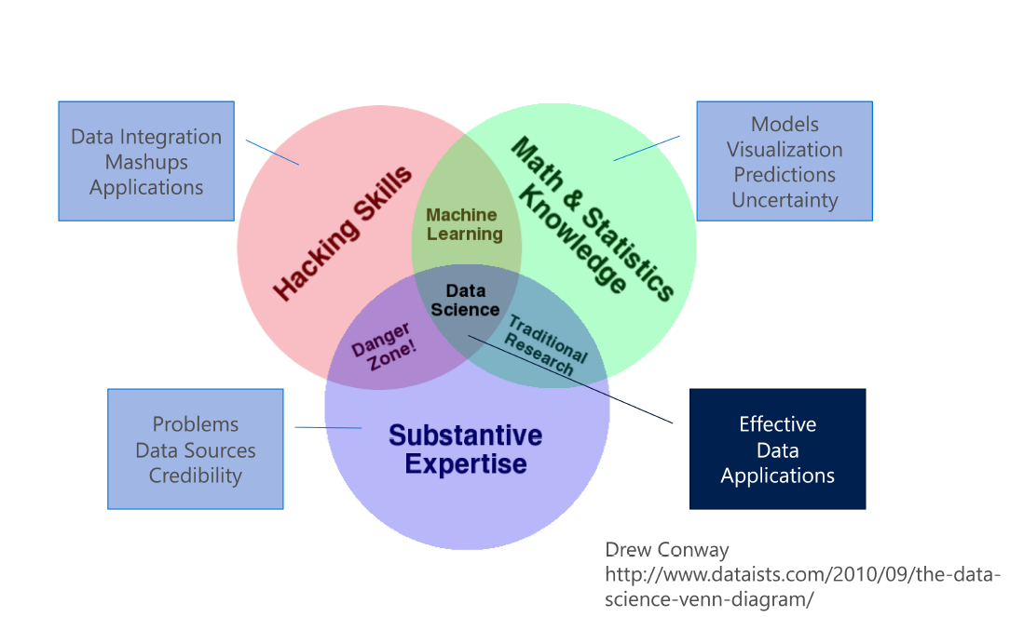
Data scientist core skills

Slide 26
Some resources
11 Clever Methods of Overfitting and how to avoid them
Big Idea To Avoid Overfitting: Reusable Holdout to Preserve Validity in Adaptive Data Analysis
21 Must-Know Data Science Interview Questions and Answers
21 Must-Know Data Science Interview Questions and Answers, part 2

